Slide 1
Parkour group
Group member: Leo, Shenxin, Alex, Amy

Slide 2
An overview of our Progress
Map Section 1 environment done
Map Section 2 implementation in progress
Hide & Seek Mode map optimization (mini-map added)
Networking problems & Git issue resolved
New features added

Slide 3
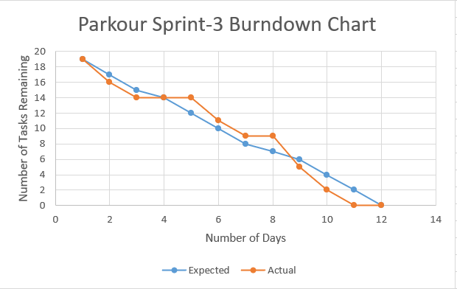
Progress of our project (Burndown Chart)

Slide 4
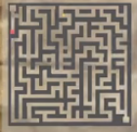

What we have done in this phase
Minimap: It will show up on the top right of the screen, which tracks your movements in the map

Slide 5
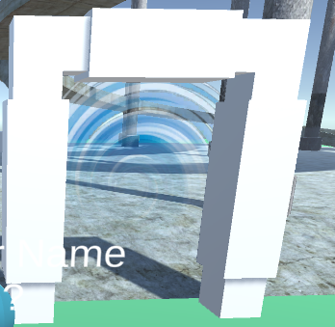
What we have done in this phase
a portal that can send you to a certain location in the map

Slide 6
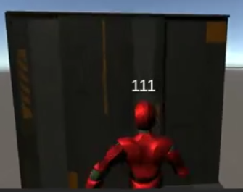
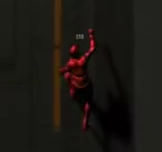
What we have done in this phase
Now you can climb up a tall wall

Slide 7
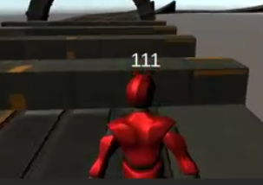
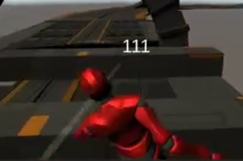
What we have done
Now you can climb over small platforms using the new 'climb over' feature

Slide 8
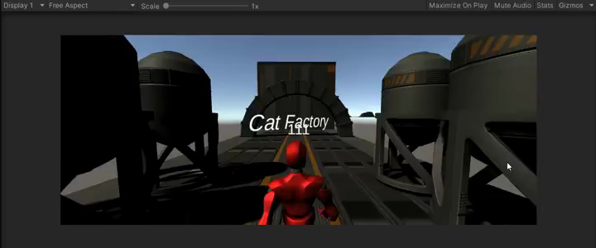
What we have done (Parkour)

Slide 9
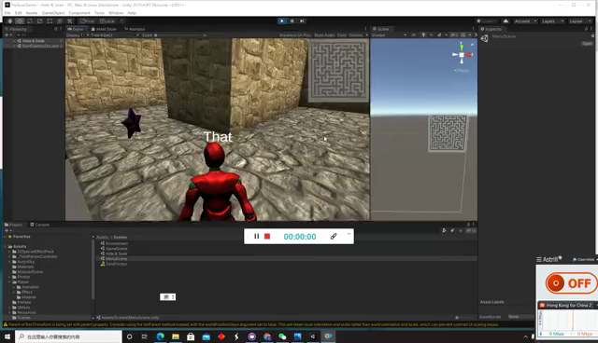
What we have done (Minimap)

Slide 10
What we are going to do
Map section 1 elements
Continue building map section 2 (in progress)
Continue adding more elements to Hide&Seek Mode
Implement Mode Choosing page and optimize the ending of the game

